Slide 1

TARGET FOLDER
SRNTGT110
Sector Command Center South (SCC South), SRN
OPAC CLASSIFIED
REL TO CJTF-23
OPAC CLASSIFIED
REL TO CJTF-23

Slide 2
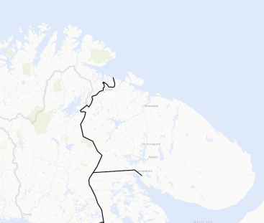
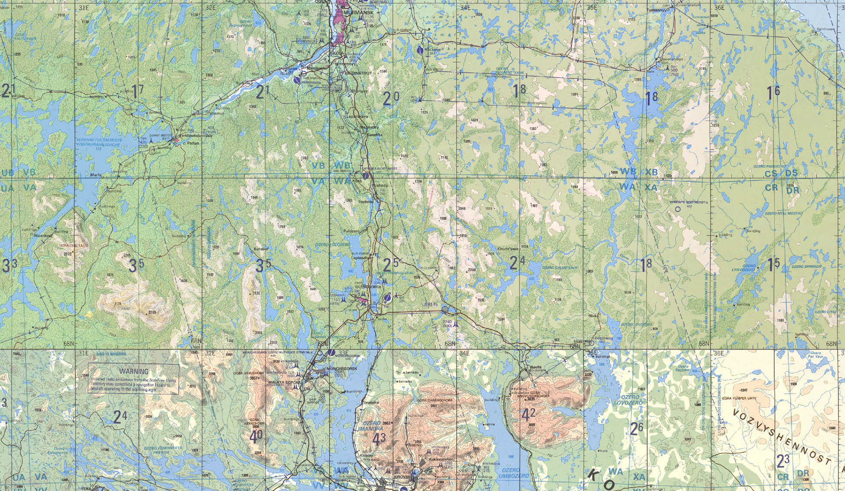
 | SECTOR COMMAND CENTER SOUTH, SRN JOINT OPERATIONS GRAPHIC | MAP OVERVIEW | OPAC CLASSIFIED REL TO CJTF-23
 | BE: SRNTGT110 CATCODE: 2 MIDB GEO: N68 09.708 E033 26.228 ICOD: 2011-07-01 DOI: 2011-05-12 |  | DECL ON: 2061-01-01(+50 YEARS)
OPAC CLASSIFIED
N
SECTOR COMMAND CENTER SOUTH
SRNTGT110
.
OPAC CLASSIFIED
REL TO CJTF-23

Slide 3
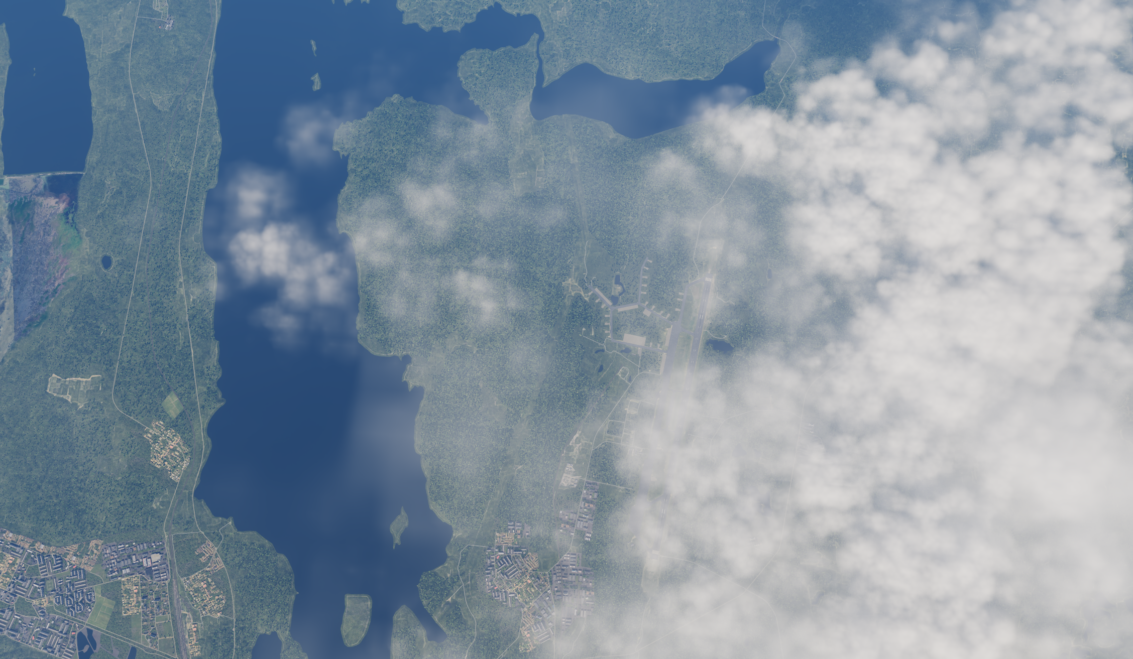
 | SECTOR COMMAND CENTER SOUTH, SRN FACILITY OUTLINE GRAPHIC | MAP OVERVIEW | OPAC CLASSIFIED REL TO CJTF-23
 | BE: SRNTGT110 CATCODE: 2 MIDB GEO: N68 09.708 E033 26.228 ICOD: 2011-07-01 DOI: 2011-05-12 |  | DECL ON: 2061-01-01(+50 YEARS)
OPAC CLASSIFIED
N
OLENYA AIRBASE
SRNTGT004
SECTOR COMMAND CENTER SOUTH
SRNTGT110
OPAC CLASSIFIED
REL TO CJTF-23

Slide 4
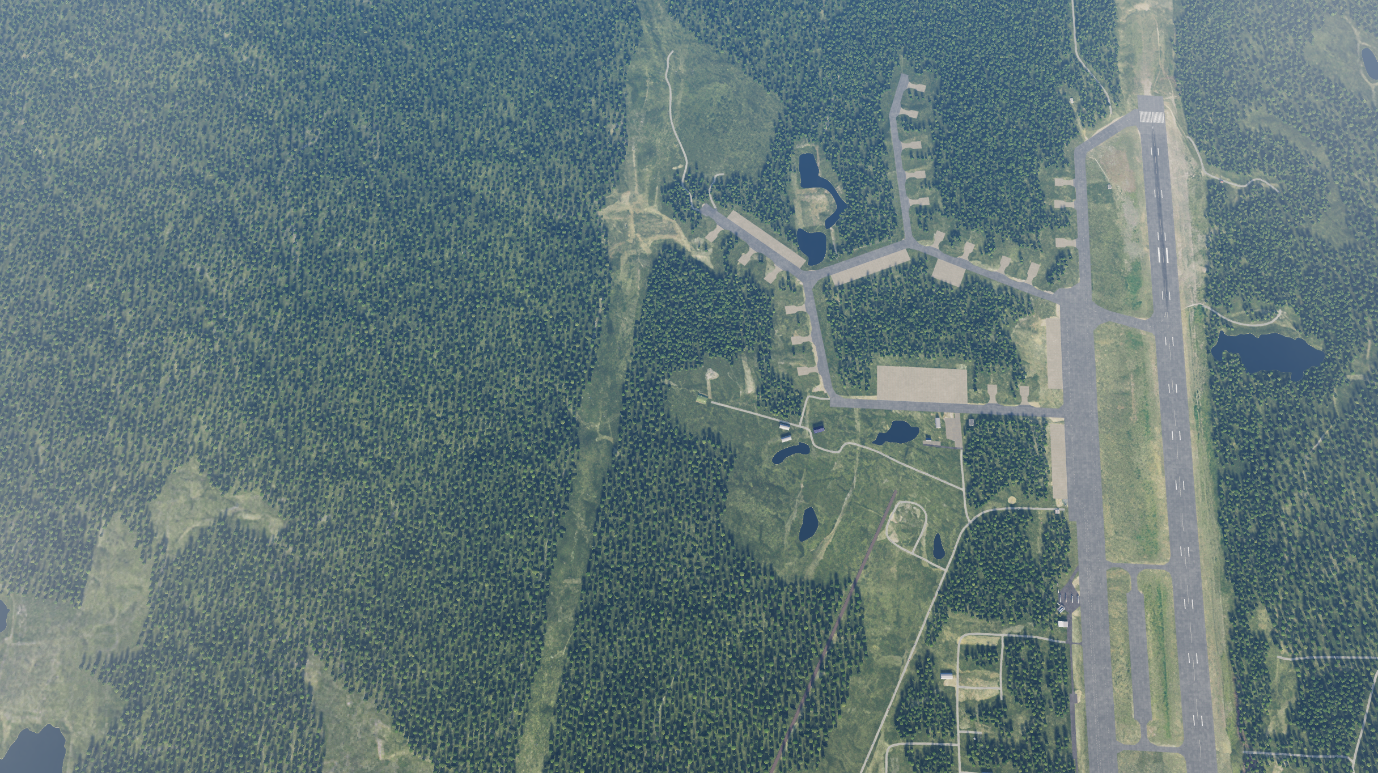
 | SECTOR COMMAND CENTER SOUTH, SRN JOINT DESIRED POINT OF IMPACT GRAPHIC [X] | MAP OVERVIEW | OPAC CLASSIFIED REL TO CJTF-23
 | BE: SRNTGT110 CATCODE: 2 MIDB GEO: N68 09.708 E033 26.228 ICOD: 2011-07-01 DOI: 2011-05-12 |  | DECL ON: 2061-01-01(+50 YEARS)
OPAC CLASSIFIED
N
DPI A
DPI: SRNTGT110A
DESCRIPTION OF DPI
N 68 09.709 E 033 26.228
DPI MSL: XXX FT
OPAC CLASSIFIED
REL TO CJTF-23

Slide 5
 | SECTOR COMMAND CENTER SOUTH, SRN WEAPONEERING OPTIONS | MAP OVERVIEW | OPAC CLASSIFIED REL TO CJTF-23
 | BE: SRNTGT110 CATCODE: 2 MIDB GEO: N68 09.708 E033 26.228 ICOD: 2011-07-01 DOI: 2011-05-12 |  | DECL ON: 2061-01-01(+50 YEARS)
OPAC CLASSIFIED
DPI | DESCRIPTION | TLE | WARHEAD | GUIDANCE | DESIRED EFFECT | IMPACT ANGLE | FUZING
DPI A | HARDENED BUNKER | CAT 2 | BLU-109 | PGM | PENETRATION | 90˚ | 60ms
OPAC CLASSIFIED
REL TO CJTF-23
Notes:
TLE 1: 0-6m
TLE 2:7-15m
TLE 3:16-30m
TLE 4:31-91m
TLE 5:92-305
TLE 6: >305m
Warhead: 500Ibs, 1000Ibs, 2000Ibs
Guidance: N/A, Laserguided, INS/GPS

Slide 6
 | SECTOR COMMAND CENTER SOUTH, SRN COLLATERAL DAMAGE ESTIMATION GRAPHIC | MAP OVERVIEW | OPAC CLASSIFIED REL TO CJTF-23
 | BE: SRNTGT110 CATCODE: 2 MIDB GEO: N68 09.708 E033 26.228 ICOD: 2011-07-01 DOI: 2011-05-12 |  | DECL ON: 2061-01-01(+50 YEARS)
OPAC CLASSIFIED
N
CER 300M / 984ft
METER | FEET
50 | 165
75 | 246
100 | 328
150 | 492
200 | 656
250 | 820
300 | 984
DPI A
NCC: [NAME] [TYPE]
830 FT E FROM DPI A
OPAC CLASSIFIED
REL TO CJTF-23
CDE 1
Notes:
CDE 1: No restriction
CDE 2: Unitary warhead only (no cluster munition), and FAH restrictions to minimize collateral damage
CDE 3: PGM, unitary
CDE 4: Weaponeering (Fuze setting, FAH, smallest possible bomb)
CDE 5: CJTF-HQ approval needed

Slide 7
 | SECTOR COMMAND CENTER SOUTH, SRN COLLATERAL DAMAGES ESTIMATION | MAP OVERVIEW | OPAC CLASSIFIED REL TO CJTF-23
 | BE: SRNTGT110 CATCODE: 2 MIDB GEO: N68 09.708 E033 26.228 ICOD: 2011-07-01 DOI: 2011-05-12 |  | DECL ON: 2061-01-01(+50 YEARS)
OPAC CLASSIFIED
COLLATERAL DAMAGES WITHIN A 500M RADIUS
DESCRIPTION |  | CATCODE | MIDB GEOS | LOCATION | REMARKS
SHED |  | N/A | N/A | 113˚/830ft from DPI A | NO FACTOR
NO STRIKE ENTITIES WITHIN A 500M RADIUS
NSE ID | DESCRIPTION | CATCODE | MIDB GEOS | LOCATION | REMARKS
 |  | N/A | N/A
OPAC CLASSIFIED
REL TO CJTF-23
Notes:
Location Example: 247˚/ 680ft from DPI D

Slide 8
 | SECTOR COMMAND CENTER SOUTH, SRN BATTLE DAMAGE ASSESSMENT GRAPHIC | MAP OVERVIEW | OPAC CLASSIFIED REL TO CJTF-23
 | BE: SRNTGT110 CATCODE: 2 MIDB GEO: N68 09.708 E033 26.228 ICOD: 2011-XX-XX DOI: 2011-XX-XX (Or reference ATO Day) |  | DECL ON: 2061-01-01(+50 YEARS)
OPAC CLASSIFIED
POST-STRIKE
PRE-STRIKE
N
TARGET OBJECTIVE
DAMAGE/CHANGE ASSESSMENT
DPI:SRNTGT110A
OPAC CLASSIFIED
REL TO CJTF-23
BDA REMARK: [CLASSIFICATION] [DISSEMINATION] Assessment: Physical Damage/change, Collateral Damage, Functional Damage/change, Munitions Effectiveness, Reattack Recommendation, Additional/Collateral Effects

